Slide 1
Title Slide
Project Name: Fingerprint Based Door Lock system
Name: Thirumalagiri Amulya
Intern ID: CITS3856
Duration: 4 weeks

Slide 2
Abstract
The Fingerprint-Based Door Lock System is a smart security system designed to provide secure and convenient access control using fingerprint authentication. Traditional lock-and-key systems can be easily lost, duplicated, or stolen, leading to security concerns. This project overcomes these limitations by using biometric fingerprint recognition to allow access only to authorized users.
The system consists of a fingerprint sensor, a microcontroller, and an electronic door locking mechanism. When a user places their finger on the sensor, the fingerprint is scanned and compared with the stored fingerprint data. If a match is found, the door lock is activated and access is granted. If the fingerprint is not recognized, access is denied, ensuring enhanced security.
This project is suitable for homes, offices, laboratories, and other restricted areas where secure access is required. The Fingerprint-Based Door Lock System offers improved security, reliability, and ease of use while eliminating the need for physical keys.

Slide 3
Introduction
ecurity plays a vital role in protecting homes, offices, and restricted areas from unauthorized access. Traditional lock-and-key systems have been widely used for many years; however, they have several limitations, such as the risk of losing keys, key duplication, and unauthorized entry. To overcome these challenges, biometric authentication systems have become increasingly popular due to their reliability and enhanced security.
The Fingerprint-Based Door Lock System is a modern security solution that uses fingerprint recognition technology to control access. Since every individual's fingerprint is unique, it provides a highly secure method of authentication. In this system, a fingerprint sensor captures and verifies the user's fingerprint against stored data. If a match is found, the door is unlocked; otherwise, access is denied.

Slide 4
Objectives
The main objective of the Fingerprint-Based Door Lock System is to develop a secure, reliable, and user-friendly access control system using biometric fingerprint authentication. The project aims to replace traditional lock-and-key mechanisms with a modern security solution that grants access only to authorized individuals. By utilizing unique fingerprint patterns for identification, the system enhances security, prevents unauthorized access, and eliminates the inconvenience of carrying physical keys. Additionally, the project demonstrates the practical application of embedded systems and biometric technology in real-world security systems for homes, offices, and other restricted areas.

Slide 5
Components Used
Arduino Uno
Fingerprint Sensor Module
Servo Motor / Solenoid Door Lock
LCD Display (16×2)
Buzzer
LED Indicators
Push Buttons
Breadboard
Jumper Wires

Slide 6
Methodology
Fingerprint Enrollment: Authorized users' fingerprints are stored in the fingerprint sensor memory.
Fingerprint Scanning: When a user places a finger on the sensor, the fingerprint image is captured.
Fingerprint Matching: The scanned fingerprint is compared with the stored fingerprint database.
Authentication:
If the fingerprint matches, access is granted.
If the fingerprint does not match, access is denied.
Door Control: The Arduino Uno processes the authentication result and controls the servo motor/electronic lock.
Status Indication: LEDs, buzzer, or LCD display indicate whether access is granted or denied.
Door Locking: After a predefined time, the door automatically locks again to maintain security.

Slide 7
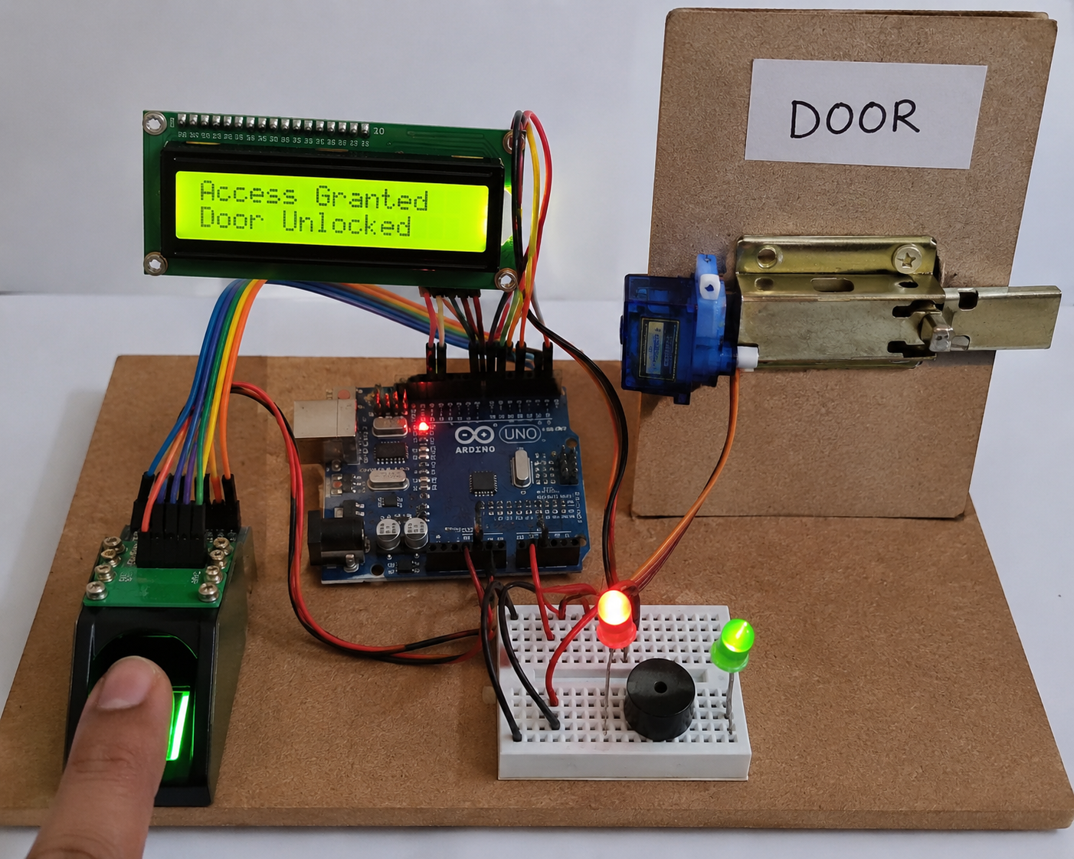
Result
The Fingerprint-Based Door Lock System was successfully developed and tested. The system accurately identifies authorized users through fingerprint authentication and grants access by unlocking the door. Unauthorized users are denied access, ensuring enhanced security.

Slide 8
Advantages
High security through biometric authentication.
Eliminates the need for physical keys.
Prevents unauthorized access.
Fast and accurate user verification.
Easy to use and operate.
Reliable and efficient system.
Low maintenance requirements.
Reduces the risk of key loss or duplication.

Slide 9
Applications
Home security systems.
Office access control.
Banks and financial institutions.
Laboratories and research centers.
Schools and colleges.
Hospitals and healthcare facilities.
Industrial and factory premises.
Restricted and high-security areas.
Smart buildings and smart homes.
Government and defense organizations.

Slide 10
conclusion
Fingerprint-Based Door Lock System is an effective and reliable security solution that uses biometric fingerprint authentication to control access. The project successfully eliminates the limitations of traditional key-based locking systems by providing secure, fast, and accurate user verification. Only authorized individuals are granted access, thereby enhancing security and preventing unauthorized entry.
The system is user-friendly, cost-effective, and suitable for various applications such as homes, offices, laboratories, and other restricted areas. Through this project, the practical implementation of embedded systems and biometric technology has been demonstrated successfully. Future enhancements such as mobile app integration, GSM alerts, and cloud-based monitoring can further improve the functionality and security of the system.

